Slide 1
Key Stage One Home Learning Meeting Welcome

Slide 2
Key Stage One Home Learning
English
Reading Book for enjoyment
Phonics Reading Book sent via Monster Phonics
Phonics homework (weekly via Google Classroom – Mr Chaplin will explain this later)
Spellings sent via Google Classroom
Maths
NUMBOTs (Yr1 & 2) and Rock Stars Times Table (Yr2)
Challenge Me Cards (Maths Focus)

Slide 3
Homework
Children will be given a weekly task related to phonics. This will involve the children sorting a selection of words into the correct sounds and writing a sentence containing the 3 sight words given.
Year 2 will complete the same activity but at a higher level.
Phonics Home Learning Books will be sent home this week. These books should remain at home and not be returned to school. Please ask when you need new books.
Homework is set on a Thursday and should be completed by the following Tuesday.
Completed work should be photographed and uploaded to Google Classroom (Mr Chaplin will explain this later).
Weekly spellings will be uploaded onto Google Classroom on Monday afternoon. The children will be tested on these words on Monday and retested on a Friday.
Home learning not completed on time has to be completed during break or lunchtimes, unless there are exceptional circumstances (in line with the School Home Learning Policy).

Slide 4
Reading
Picture cues.
Sounding out individual letter sounds.
Blending initial and final sounds.
Breaking into syllables - e.g. be/come
Contextual cues - e.g. William turned the l_ _ _ _ on.
Grammatical cues - e.g. Bang!
Children should read their book twice (decoding and understanding) until they have reached turquoise level.
It is expected that all children read at least 4 times a week.
All children that have read 4 times that week will be rewarded.

Slide 5

Reading Records
Please record in your child’s Reading Record each time they read with an adult.
Please be specific and state what page they have reached. If your child needs to change their book (read twice until Turquoise level), we kindly ask for parents to draw a simple outline of a book to remind your child to change it the following morning.
It is also beneficial to occasionally include details of how they have read (expression, prediction).
We encourage the children to be responsible for changing and tallying the books they have read, this is something we practise in Year 1.
The tally chart will be completed in school, please do not edit this at home.

Slide 6
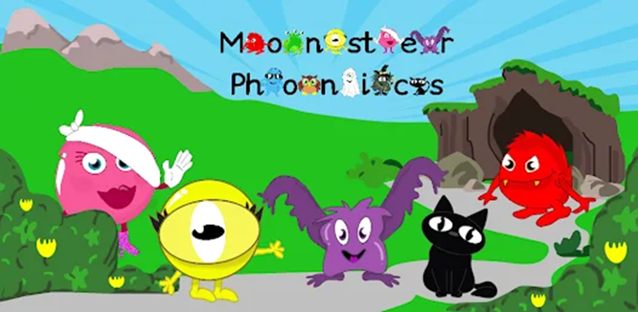
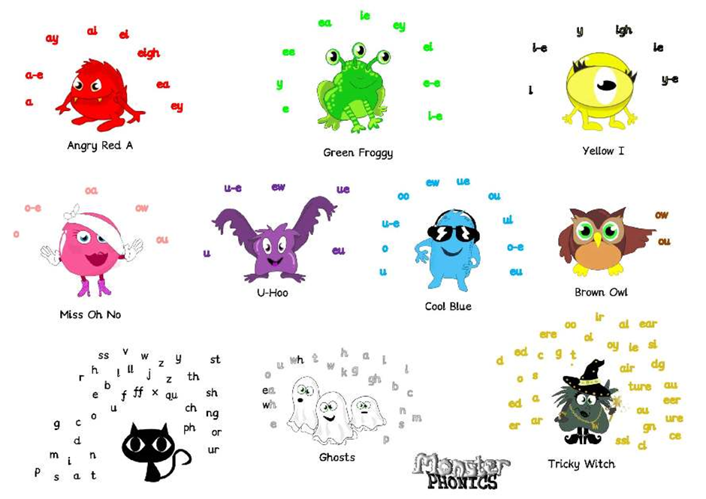

Slide 7
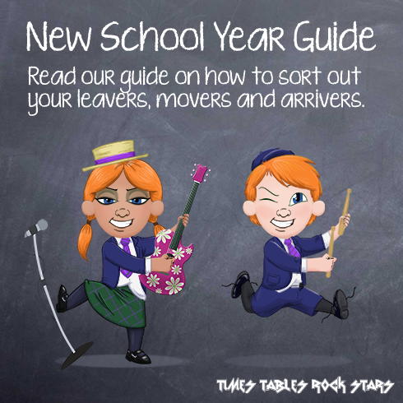

Rock Stars Times Tables and NUMBOTS
https://ttrockstars.com

Slide 8
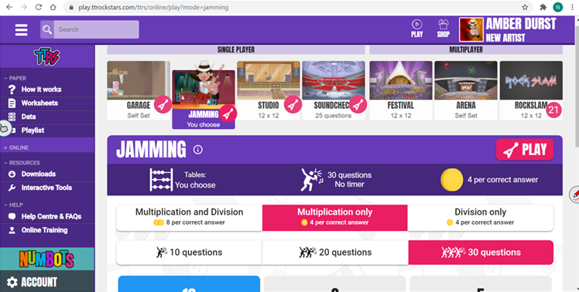
Rock Stars Times Tables

Slide 9
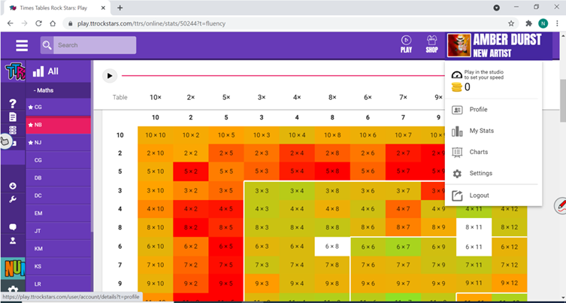
Rock Stars Times Tables

Slide 10
Multiplication and division
Multiplication - year 1 children should know by heart at least their 2, 5 and 10 times tables by the end of the year.
Multiplication and division - year 2 children should know by heart at least their 2, 3, 5 and 10 times tables and division facts by the end of the year.

Slide 11
Other Home Learning
On occasion, projects homework tasks may be set.
This will be set 2 weeks before a half term to allow plenty of time.

Slide 12
Google Classroom

Slide 13
If you have any questions, please email the admin address: admin@robertdrake.essex.sch.uk
Thank you for all your help and support.

